Slide 1
Corporate Culture: Evidence from the Field
John R. Graham, Campbell R. Harvey, Jill Popadak and Shiva Rajgopal
November 7, 2015
Notes:
Acknowledge co-authors
Virtually every conversation with CFOs or CXOs in the last 10 years involves a reference to culture or tone at the top
Been meaning to go back and explore this topic in greater depth but we have never got down to doing it because culture is a difficult topic
Multi dimensional, hydra headed beast that is hard to tame, several frameworks have been proposed to measuring culture in management literature but hardly much here in econ based work
The JAE call served as a catalyst to go out and tackle the problem

Slide 2
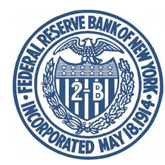

Corporate Culture: Evidence from the Field
John R. Graham
Duke University and NBER
Campbell R. Harvey
Duke University and NBER
Jill Popadak
Duke University
Shiva Rajgopal
Columbia University
New York, November 12, 2015

Slide 3
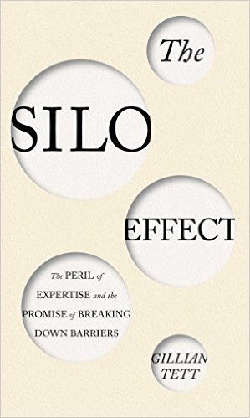
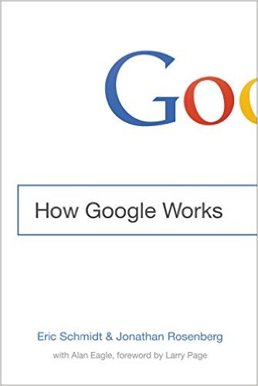
Corporate culture claimed to drive huge failures/successes
Notes:
Culture is especially topical now, given the emphasis of the banking regulators. A lot of recent stories in the press.

Slide 4
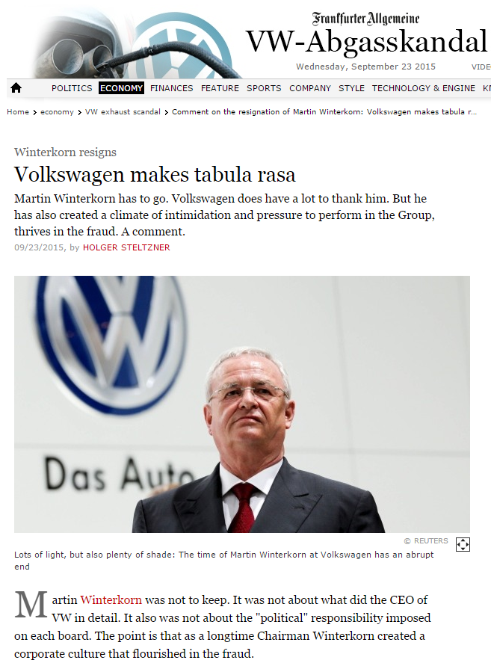
The VW episode
“Chairman Winterkorn created a corporate culture that flourished in the fraud.”
Notes:
2004 bribery scandal- to recover from that Winterkorn’s predecessors wanted to (i) cut costs; (ii) break the cozy relationship between labor and management. That created a power struggle., new mgt took credit for good news and blamed prior mgmt. for bad news. Small group of managers who wanted to construct an engine of the future

Slide 5
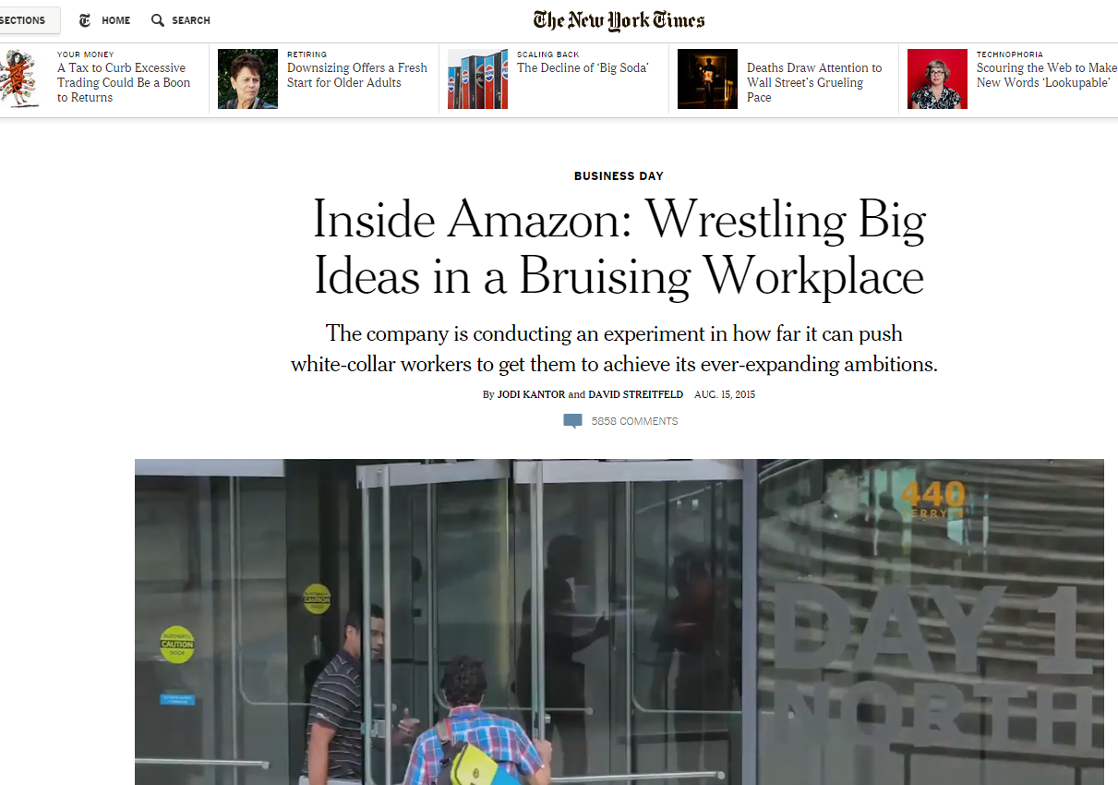
Amazon workplace controversy

Slide 6
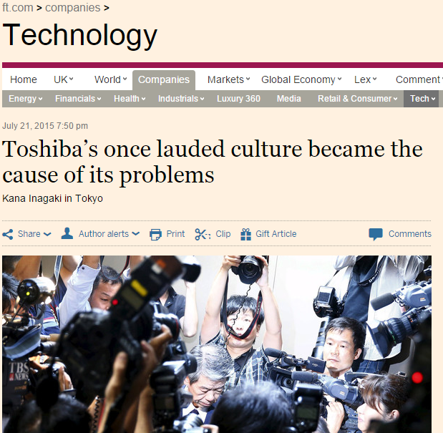
Toshiba’s culture and accounting scandal
Notes:
Despite being asked to reopen the books of the PC division, the former CFO and head of the audit committee would refuse saying that would miss the earnings deadline. After the Olympus affair in 2011, on paper, Toshiba looked “independent” in terms of governance structure. External auditors in audit committee had no accounting expertise. Half the inflated profits in the year of tsunami and inflated yen! s Japan’s “reflective obedience” and “reluctance to question authority” for contributing to the poor handling of the disaster.

Slide 7
Systematic analysis of corporate culture just emerging in fin/econ/acctg.
A handful of papers
Some theoretical (e.g., Kreps 1990, Lazear 1995, Hermalin 2001)
Many culture frameworks (e.g., O’Reilly et al. 1996, Cameron et al. 2006)
A few published empirical pieces (e.g., Guiso et al. 2006, 2015; Davidson et al 2015, JFE culture issue 2015)
A handful of working papers (e.g., Bargeron et al. 2012, Bereskin et al. 2012, Popadak 2015, Kedia, Luo, Rajgopal 2015)
Several barriers to advancement of this literature
No consensus on definition
Is it a first-order driver of value worth exploring?
How does culture originate, how sustained, consequences of in/effective corporate cultures?
Considerable difficulties with empirical measurement

Slide 8
We take a first crack at this problem via a field study
Questions we explore:
What is corporate culture? How important is corporate culture?
What mechanisms underlie the creation and effectiveness of corporate culture?
How do other corporate policies (e.g., compensation) reinforce or work against culture?
What aspects of business performance does corporate culture affect?
Does culture impact corporate risk-taking, growth, financial and tax reporting, whether employees take a long-run view, or corporate ethics?
Are the upside benefits of effective culture greater than the downside costs of ineffective culture?
What deters a firm from having the ideal corporate culture?
How can corporate culture be measured?
Survey is on http://corpculture.org/survey.htm (just closed on Oct 31)

Slide 9
Field study: strengths and weaknesses
Obligatory but important slide about the methodology
Given the early stage of this literature, interviews and surveys are a great way to address the questions we are interested in
Measurement of corporate culture is in its early stages, good proxies are hard to come by
However, concerns include potential response bias, limited number of observations, whether questions on a survey instrument are misinterpreted, do respondents do what they say, do they tell the truth, do they recall the most vivid or their most representative experience, hard to assert causality given the one-shot nature of the survey.
And, is the survey comprehensive enough to pick up multiple dimensions of culture, will we get the same results if we survey rank and file employees, not CXOs
Nonetheless, the hope is that insights we gather inform future empirical and theoretical work in the area by unearthing observations that other traditional methods cannot.

Slide 10
Interviews and survey
Interviewed 18 CXOs from 10/14-11/15
Interviews: Very large firms, Mean sales last year $47B, median $35B
Survey just closed, started Sep 15, 2015, closed Oct 31, 2015
Base data come from Duke’s email list of CFOs who take their quarterly survey and Columbia’s alumni list of CEOs and CFOs (includes several divisional CXOs)
Survey takes between 12-20 minutes to complete
The response rate is 13.4% from the main sample, we have 1,461 North American responses overall.
Compared to Compustat, survey firms are larger, more profitable, less levered, but slower growing

Slide 11
What is corporate culture? Interview insights
Interviews suggest the following definitions
“a beliefs system,” “a coordination mechanism,” “a social control system,” “an invisible hand,” “how employees interact with one another,” “a standard of behavior,” “norms around how people treat people,” “part work ethic, part ambiance of the work environment,” “how the company really works, the operating style,” and “the tone for what type of company this is.”
Culture shapes the employees’ expectations
“culture is beliefs and behaviors that build expectations for performance in various different ways for individuals and the company overall”
Firm specific culture is often characterized by executives in terms of values
“our employees live and breathe the culture of shared core values,”
Consistent with Kreps (1990), “employees face contingencies when working that cannot be fully specified ahead of time in a labor contract, so they must choose what values to apply”

Slide 12
What is your corporate culture? Survey question
Q0. “Briefly, what words or phrases best describe the current corporate culture at your firm?”
We classified responses into six types:
Entrepreneurial: “start-up culture, “aggressive,” “scrappy,” dynamic,” “charming chaos,” “innovative,” thinking outside of the box” and “reaching beyond the obvious.”
Hierarchical: “buttoned down,” “traditional” and “centralized”
Collaborative: “open,” cooperative,” “friendly, “family like,” “participatory,” “universal recognition no superstars”
Results oriented: “customer focus” “results driven,” “service first,” “continuously improving,” “high performance”
High integrity: “compliance driven,” “credibility,” “accuracy of financials”
In transition
Dysfunctional: “selfish”, “rudderless,” “confused,” “mercenary”
Notes:
Struggled with this a lot. Should we have some dimension in mind (cooperation/competition) and force people into a 2x2 but we noticed so much diversity in how people describe their culture in the interviews, that we decided to ask for just words.

Slide 13
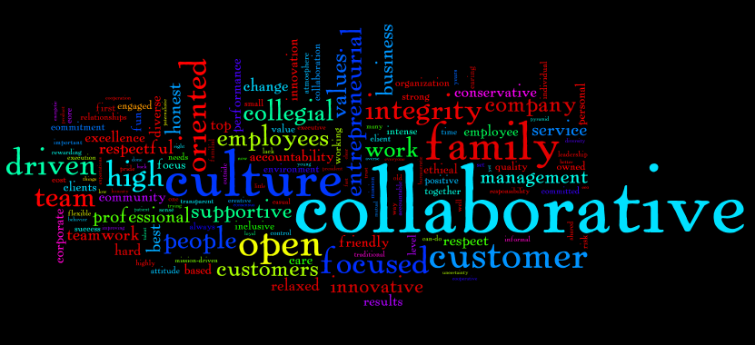
What is your corporate culture? Survey question

Slide 14
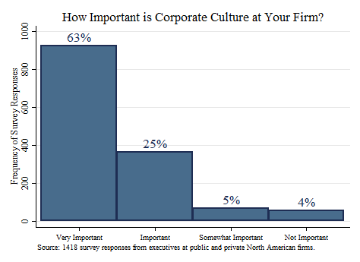
91% think culture is important at their firms
Q1. How important is corporate culture at your firm?

Slide 15
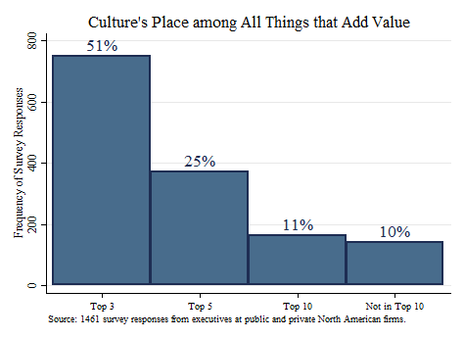
76% place culture in top 3 or 5 value drivers
Q2. In terms of all of the things that make your firm valuable, where would you place corporate culture?
Notes:
Routinely placed among the top three value drivers of the business
Various CFOs rated culture as more important than brand, employee talent, financial health, leadership, market position, operating plan, product, unique competitive advantage, and vision for the company
“A good culture can lead to better results. If you started two businesses, they had the same manufacturing process, same raw materials, distribution, everything was the same" and one had an effective culture and one had an ineffective culture, the good culture would outperform the bad culture.”
“This is because the people in the effective culture would be working towards mutual success, they would all be striving to achieve success, whereas in the ineffective culture, people might just be in it for themselves, trying to get up the corporate ladder, just a more divisive environment.”
A firm with an effective culture and mediocre strategy will outperform a company with an ineffective culture and superior strategy
“culture actually helps even if you don't have a great plan and you're not communicating well because culture helps tremendously to make sure that you are continuing to do the right things for the company in the long run”
Executives estimate that culture adds between 5 percent and 50 percent to firm value, with the distribution centered on 15 to 20 percent
“if key people walked away, you would short the business immediately.”
“the reason the stock price goes down when key people leave is that people are worried about culture and continuity. You take a lot of disruption if you lose people and have to reform its culture and figure out how to execute”
“culture can be described as foundational…because it can influence your ability to come to solutions to all the unknown problems and challenges that you will face from inception to growth”

Slide 16
Close to a majority would walk away from the deal
Relative to how much you would offer for A, how much less would you offer for company B due to the culture misalignment?
46% would not make an offer,
7% would offer >30% less than A’s offer price
12% would offer 20% less than A’s offer price
9% would offer 10% less than A’s offer price
2% would offer 5% less than A’s offer price
9% would pay the same amount as for A
“If the gap was wide enough it did not matter if it was a great price. We won’t move forward”
The literature has largely missed the importance of culture in M&A transactions.
Notes:
You work at a firm with an effective, strong culture. You are evaluating two acquisition targets, A and B. •
A and B would bring the same strategic and operational benefits if acquired, and the targets are identical in all dimensions except corporate culture.•
Company A's culture is very aligned with your firm's culture, whereas company B's culture is not at all aligned.
Firms with collaborative cultures are less likely to acquire other firms
“A collaborative culture...has a downside though of perhaps making it harder to rapidly expand into groups that don’t understand it”
Cost synergy mergers should work regardless of culture whereas revenue synergy mergers are where culture matters most
“I have to work within these various ecosystems, different cultures and personalities, but achieve the growth targets we need. The only way we can do that is to have an understanding and respect of the different cultures, and have them working together”
Tension exists between traditional hiring and firing and talent acquisitions in terms of cultural fit:
“we’ve been more successful with injecting new talent and new people into the business with acquisitions than with mid-career hires. The success of keeping the talent after an acquisition, can be hugely determined by how much you can help ease them into this strong culture”

Slide 17
Only 15% say their culture is where it should be
15% say our corporate culture is exactly where it should be
54% say our culture needs some work but is close to where it should be
21% say our culture needs considerable work to get to where it should be
11% say our culture needs a substantial overhaul;
Q3. Do you believe that improving your corporate culture would increase your firm’s value?
92% say yes

Slide 18
What deters a firm from getting to an effective culture: poor leadership
Notes:
Need new leadership
sometimes, new leaders subvert a culture for the better
Unstable leadership
perpetual change at the top and their reengineering of what they’re going to do and how they’re going to go to market creates a culture where the associates are very unsure of what is going to happen.
Archaic business model:
“the main business was a cash cow that is going to decline over time if we don’t change something.”
Not engaging the rank and file: “
“we can sit up here all we want in corporate headquarters, but unless we can convince people in the field to get on board of what needs to happen, this ain’t gonna work.”
Excessive focus on consensus building:
“you don't move without consensus, apparently they think that companies are democracies instead of benevolent dictatorships. And so, unless somebody raises their hand, nothing gets done.”
Misaligned incentive systems:
The stack ranking episode discussed earlier
Excessive reliance on formal controls:
“a branch manager of one of our many branches, used to have three or five goals that would be looked at once a month. That was replaced by a set of 80 different performance measurements.
Short-termism:
There was the perception that we could sell the XXX stock and get 100 percent of the value, and therefore could buyback more stock. So that was done. Then along comes 2008, when all that capital would have been nice to have.”

Slide 19
Current CEO is the biggest influence on culture
“the board does not affect culture other than choosing the CEO”
Notes:
Leaders define the firm’s culture”
The founder’s values mattered a lot to younger firms
“when you get to a certain scale at which leaders of the company realize that their direct action is not enough to reinforce certain behaviors, culture begins to pick up and carry out their will in a more subtle way and extends their influence”
The primary role of leaders was to instill a common belief system in the whole company
a good leadership team and good CEO will put the processes to make sure the message filters down to very bottom of the organization unchanged.
However, instilling a common belief system in the whole company “is very difficult”
culture ate the strategy for lunch, because the behavior and the assumptions and the social contract and all that stuff really didn't fit the vision of where the company was going.'”
A few thought that leaders, effective in one culture, might fail in another.
Ron Johnson who “left Apple, one very unique culture, and came to JC Penney, a very different culture, trying to bridge and change that organization and bring it along didn’t work.”
Very few CFOs thought that a bottom-up culture was a realistic proposition:
“the corporations are set up, they’re benign dictatorships. Whether the dictator or CEO is benign or not, he or she will shake the culture through strong will or by behavior. If the CEO is not strong to drive the agenda of the board, the board will replace the CEO, so culture always comes from the top.”
One CFO thought that poor leadership leads to a bottom up culture:
“for many companies that maybe don’t have leadership that pays attention to culture, you are stuck with more of a bottom-up approach to your culture. In those situations, the lower levels of the organization are driving a lot of the culture.”

Slide 20
Current culture: a deeper understanding
Factors underlying effective cultures:
Employee engagement
Coordination/trust/communication
Learning dynamics
Sense of urgency
Critiquing and whistle-blower behaviors
Industry
Modifiers of corporate cultures:
Modifiers reinforce or dilute the role of the above factors
Corporate governance
Compensation structure
The role of the finance function

Slide 21
Factors underlying effective culture: Trust is key

Slide 22
Underlying effective culture: Coordination/engagement
Coordination/trust/communication
Example of how to build engagement:
“we take new employees through history, we give them some books of past writings and have meetings where in some cases we'll ask an employee to talk about a critical policy or historical thing that happened in the past”
“promotion from within, its celebration of things that demonstrate the culture, its finding little hero stories among our employees that go to extraordinary lengths and celebrating those things.”
Importance of culture that will facilitate employee whistle blowing:
“you have seen the frauds and these things that haven’t gotten reported because there has been a culture of fear or loss of job.”
Market position affects the firm’s cultural effectiveness:
“I do think that being a market leader for a long time with very reliable revenues has colored our outlook, has maybe made it more defensive.”
Notes:
Having employees aligned on what-type of actions are laudatory enabled an effective culture:
“If half of the employees are very competitive but another half of the employees are collaborative, the interactions between the employees will encumber employee productivity”
Important that employees’ approach to doing business is predictable, consistent:
“Knowing how your boss will react to something. Sometimes, even if it’s not positive – rather than being like I have no idea if my boss is going to fly off the handle, like am I going to get fired or promoted as a result of this. That sense of uncertainty, I think, is bad.”
Many approaches to effective culture plausible but consistency important:
“If I want to design a product, I tell you with 100% certainty that the first thing that people in my firm will do is observe consumers using this product. If you ask people at another firm I’ve worked at, they will lock themselves in a room, and start dreaming it up without talking to a single consumer. That would drive the people at my firm nuts but both can be equally effective.”
Engagement reflects the portion of employees that commit to the cultural values
The CFOs also highlighted the difference between aspirational and actual cultures and that disengagement occurred when employees only viewed the aspirations as lip service
Example of how to build engagement:
“we have internal videos, internal other messaging, various newspaper articles that go out to all of the employees to continually reinforce what the culture is. In addition, every year, the CEO exerts great effort to achieve the difficult task of getting in front of all of the employees in an effort to reinforce the culture as well.''
“we take new employees through history, we give them some books of past writings and have meetings where in some cases we'll ask an employee to talk about a critical policy or historical thing that happened in the past”
“promotion from within, its celebration of things that demonstrate the culture, its finding little hero stories among our employees that go to extraordinary lengths and celebrating those things.”

Slide 23
Modifiers of culture: Senior mgmt./Board/Comp/Finance
Table 6: What reinforces culture?
Panel 6A: Survey Responses to the Question: Modifiers behind the firm's culture
Do the following items reinforce or work against the effectiveness of your corporate culture? |  |  | % Works against | % No Impact | % Works for
 |  | Mean | (-1) | (0) | (-1)
 | Senior Management Behavior | 0.56 | 20% | 5% | 75%
 | Finance function/department | 0.42 | 8% | 42% | 50%
 | Governance/Board of Directors | 0.45 | 11% | 33% | 56%
 | Incentive compensation | 0.37 | 20% | 23% | 57%
 | Other | 0.30 | 18% | 34% | 48%
Senior mgmt/board and comp can work for (56%-75%) and against the culture (11%-20%)
Notes:
Not obvious that all boards contribute to culture creation and sustenance:
Stronger effective boards had a greater impact on culture than weaker ineffective boards
“the board is not very engaged because we tend to have an older board and they are all retired at this point”
“there is no one in the boardroom pointing their fists. The people on the board are for the most part, handpicked by the CEO and share his long term vision”
board sets the overall tone but does not get involved with the nitty-gritty of the implementation of cultural values
Others thought boards critical in determining culture for positive and negative outcomes:
“I think it is important, critical for boards to try to fully understand and appreciate the aspirational and the actual culture”
Influential board members, especially long serving ones, serve to carry cultural values of the firm, across generations of board members

Slide 24
Modifiers of culture: How compensation helps and hurts
“Incentive compensation is strong motivator and driver of the behavior and ultimately if that is not aligned with culture it will change the culture”
Notes:
Incentive compensation is strong motivator and driver of the behavior and ultimately if that is not aligned with culture it will change the culture”
Stack ranking demotivates employees:
It doesn't motivate people to cooperate; you don't want to help the guy next to you because they might do better than you.”
Compensation structures that redirected employee efforts away from the aspirational culture invariably rewarded employees for achieving a metric without regard to the actions they took to achieve that metric.
“the easiest thing is to pay off the metrics, but you could end up with a bunch of people that you don't want to have around you.”
Executives strongly believed the key element to the structure was fairness.
“compensation has to be right in terms of the market place. Compensation has to be perceived as fair and awarding performance or else your culture gets screwed up”

Slide 25
Modifiers of culture: How the finance function helps and hurts
“Without the finance function's culture of integrity, compliance, etc… the behavior of executives end up a lot of time destroying what it took them years and years to build
Notes:
``Finance holds a very special place in an organization. Finance employees are both the guardians of integrity but also the mirror of the organization because sometimes people think they're much better than they are.”
“Without the finance function's culture of integrity, compliance, etc… the behavior of executives end up a lot of time destroying what it took them years and years to build.''
Examples of the finance function working against the effectiveness of the culture involved employee engagement and communication.
In these examples, executives often cited how the level of respect finance employees had within an organization led the finance employees themselves to not commit to the culture or undermine other employees' efforts (e.g., finance in high-tech businesses seen as inferior to engineering)

Slide 26
Consequences of effective culture : Risk taking
Executives reported that culture enhances firm performance through the risk-reward trade-off.
“we do tend to take a little more risk because of having this long-term perspective that comes from our culture.”
Do you think your company takes the right amount of risk in its investments to achieve its goals?
57% say right amount of risk
27% say too little risk
11% say too much risk
So, conservatism is a bigger issue in our sample than aggressive behavior
Notes:
Executives reported that culture enhances firm performance through the risk-reward trade-off.
“we do tend to take a little more risk because of having this long-term perspective that comes from our culture.”
The link between risk and performance is not always easy to incorporate in formal models of risk:
For a small company, in a rapidly growing business environment, risks don't so much look like risks at the time when you are making decision. The risk is in the ability to predict future potential and that is risk you cannot conceive of in the same way as a return on investment problem."
Several CFOs highlighted the need to tolerate failure:
“There’s a little bit of a cultural safety blanket there that allows people to take risks in their career.”

Slide 27
52% think culture important for excessive conservatism

Slide 28
Consequences: Interviews on short termism
CFOs felt that a strong culture helps them to avoid short term pressures;
“I think we do tend to take a little more risk because of having this long-term perspective from my strong culture.”
One CFO alluded to the connection between culture and the firm’s myopic reporting behavior,
“I do think culture matters in the attitude on quarterly earnings and stock price matters.”
Notes:
CFOs felt that a strong culture helps them to avoid short term pressures;
“I think we do tend to take a little more risk because of having this long-term perspective from my strong culture.”
A few CFOs lamented that they sometimes do not get credit from the market for long term decisions:
“We certainly do not get credit for culture related investments particularly if you think of the short-term nature of some of our investors. Our long-term investors get it and understand it completely.”
One CFO alluded to the connection between culture and the firm’s myopic reporting behavior,
“at XXX, CEO YYY cared a lot more about stock price and making earnings. YYY was prone to push me very hard on accounting treatments and I couldn't stand it. You get very different leaders with different dynamics going on. I do think culture matters in the attitude on quarterly earnings and stock price matters.”

Slide 29
35% will take inferior NPV project
Suppose your firm is considering two projects A and B
A and B are very similar in that they require the same capital up front, have the same expected life, and have the same probability of failure
A is more valuable than project B (A has greater NPV)
A generates negative cash flows for the first two years, while B has positive cash flows in all years
Assuming all cash flow forecasts are equally accurate, does your firm’s culture make it more likely that project A or B will be chosen?
50% said project A
35% said project B
15% were not sure

Slide 30
Culture associated with short termism
Question | Does the firm’s culture play a role in the preference for project A? | Number | Percent
(1) | Yes | 537 | 80
(2) | No | 133 | 20
Question | If culture improved, would project A be chosen? | Number | Percent
(1) | Yes | 237 | 56
(2) | No | 187 | 44

Slide 31
Culture crucially linked to ethical behavior
Question | Do you think having a poorly implemented/ineffective culture at a company increases the chances that an employee would do something unethical (or even illegal)? | Number | Percent
(1) | Yes | 1012 | 84
(2) | No | 186 | 16

Slide 32
77% say effective culture reduces value destruction via real earnings mgmt
Question: Sometimes companies engage in end-of-quarter practices such
as delaying valuable projects to hit market expected earnings.
Question | How likely is it that an effective corporate culture would reduce the chance that such actions are taken? | Number | Percent
(1) | Extremely likely | 218 | 18
(2) | Very likely | 437 | 35
(3) | Somewhat likely | 298 | 24
(4) | Not likely | 214 | 17
(5) | Don’t know | 70 | 6

Slide 33
Consequences of effective cultures: productivity/creativity/firm value
Notes:
Culture enhances firm performance because it enables superior execution
“Culture is like the tendons and ligaments that hold the body together and allow it to be healthy as a body and execute daily."
“Culture is your sheet music to success. It is no different than an orchestra. You can hire the best trumpet players, oboist, violinist, and unless they are all playing from the same sheet of music at the right temper, you will fail. If you have the trumpets playing too loud, the song won't sound right. It is that delicate balance of getting people on the same page."
Culture enhances firm performance through reduced agency costs.
“it reduces dramatically the agency costs within an organization because you have an invisible hand at work inside of each of the employees that helps to guide their decisions and judgments in a way that the overall corporation would desire it to be.
Value part of the culture-performance link is more apparent in a challenging macroeconomic environment.
“culture is more important in the bad times than in the good times. The rising tide lifts all boats, everyone looks good in the good times. In bad times, the companies that don't' have a good foundation, hurt more. If a company has bad culture and they are in financial stress, then they are gone or they will start losing their best employees."
Culture has a unique role in that it can substitute or make-up for mistakes in a way that other executive actions or firm assets cannot.
“Great culture with right values, focus will deliver results even with a mediocre strategy." Similarly, another executive states, “if I think about strategy and execution, mediocre strategy and great execution you can get by. So, I think culture helps implement execution and to that extent, I would say culture is very important."
Culture is like the air, it can be almost invisible and easy to move through, but if it's extremely strong and it can be a hell of a tailwind or a headwind."

Slide 34
How to measure culture - interviews
Conference call transcripts/analyst reports
Employee age/tenure
Company’s external communication
Press portrayal of the CEO
CEO change
Culture of the prior firm of the CEO
Culture-environment fit
External websites with employee opinions
Uniform commitment across the company
Communication patterns
Corporate actions
Notes:
Conference call transcripts/analyst reports:
“you can pick out the tone and the words of the CEO and lot about the culture and how he refers to the results, how they got them, how he talks about his people, how they talk about customers and what he/she emphasizes. That would give you lot of clues.”
“ ifyou can find the right five or six analysts that cover companies, most of them will take the time to go out and visit the company in person, meet the management teams, and you can hear in their notes their feelings about the company.”
Employee age/tenure:
Age because it gets you some sense of which generation and the diversity of age, so you get the demographic pieces of the firm.”
“when Welch was head of GE, he stated openly that he expected 30 percent of turnover in leadership positions each year. He moved out people he thought were underperformers and brought in or advanced, in either case, and kept movement within the leadership organization.”
Company’s external communication
Press portrayal of the CEO: “
“I think reading articles that have been written on the CEO can provide some light on how things are run and the culture.”
CEO change:
“you should look at where there has been a change in the CEO role, where they have brought the CEO from the outside to the company, and to track what operational changes were made. That will showcase cultural changes. JC Penney is the perfect example.”
Culture of the prior firm of the CEO:
“The CEO had come from YYY. So many aspects of the culture were adopted from YYY.”
Culture-environment fit:
“Do the cultural attributes represent the future of the company, or the past? So it’s really an issue of, is the culture in sync with the needs of the business.
External websites with employee opinions:
“of course the content there has a negative bias, but you will get a sense of what people really think about the corporate culture.”
Quantifiable metrics on issues like spending on employee benefits are tempting to rely on but “if you really want to understand how people think about the culture, you need to read comments from people who are at the company or have just left.”
Uniform commitment across the company:
“If you have 10 people at five different units, do you have a strong culture or not? Or is there a strong sense of common beliefs?
Communication patterns:
“Try to get dumps of an organization’s communication patterns. Get anonymous information about the company’s top 500 users and observe how information passes around. Get data on who is emailing whom and when. Who is creating meetings?”
Corporate actions

Slide 35
How to measure culture - interviews
Don’t rely too much on external trappings
“we have 100% retention, but are we retaining the people that are crap and we really need to fire them, but we don't really like to fire people, so we just move them around all the time”
Don’t rely on mission statements and employees’ code of conduct
“so much focused on the behavior that aren’t acceptable and compliant and they look very similar from company to company”
“At XXX, they were very good at talking about it and having that vision and getting it out there and communicating it clearly. It was just the implementation where they sucked”
Only 51% said their current culture tracks their stated goals
Conclusion: given the multi-dimensional nature of culture, use the proxy that picks the narrow sub-culture you are after (e.g., compliance culture) or use multiple measures.

Slide 36
Conclusions
Corporate culture is a first order driver of firm value, profitability, M&A decisions, risk taking, short termism, ethical behavior and real earnings management
Current leadership has the biggest influence on culture
Compensation and governance can amplify existing culture
Despite its importance, the area remains highly under researched
Perhaps the barrier is measurement. We have tried to provide ideas on how to try and gauge culture from publicly available data
Coming up with valid measures and archival validation of some of our findings is a potential next step for the field
We have lots more qualitative and quantitative data that await analysis!

Slide 37
Conclusions
The most significant offense to the Coasean tradition … is the downgrading of honest descriptive work… A statistical or historical investigation that does not pretend to identify a causal relationship but does illuminate facts that need further exploration is what I would regard as something that is vintage Coasean tradition.
Sam Peltzman, September 16, 2015

